Slide 1
Dress for Success
Appearance and Nonverbal Communication
Notes:
A job interview is your chance to meet face to face with a potential employer and hopefully make a good impression which will result in a job.
1

Slide 2
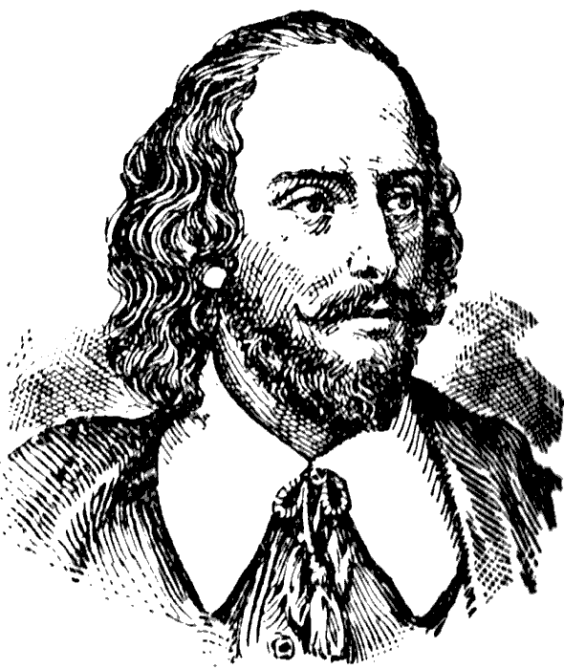
Dress for Success
“You never have a second chance to make a first impression”
Unknown
“The apparel often proclaims the man”
William Shakespeare

Slide 3
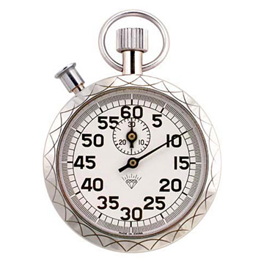
First Impressions Count
It takes less than 5
seconds to form
a first impression.
Social Status
Health
Education level
Intelligence
Ambition
Notes:
You only have once chance to make a first impression. You’ve heard the saying a picture is worth a thousand words.
When you walk in and meet a potential employer he first sees a visual image of you.
3

Slide 4
Personal Image
Is the tip of the iceberg… only a fraction shows
Your image has the power to attract or repel others
Take advantage of your personal image make it a walking advertisement!
Notes:
4
From the time you walk into the room it takes less than 5 seconds for the employer to get a first impression.
Your appearance reveals your health, age socioeconomic status, education, ambition, kindness and approachability.
Studies show it can take 21 repeated good experiences with a person to make up for a bad 1st impression.

Slide 5
First Impression… How are you judged?
Appearance and body language = 55%
How you talk = 38% intonation, pacing and inflection
What you say = 7% verbal content
Notes:
What the employer sees is only the tip of the iceberg. He only sees about 3 percent of who you really are.
The image you project in those first few seconds can repel or attract others.
5

Slide 6
Studies show it can take 21 repeated good experiences with a person to make up for a bad first impression.

Slide 7
Handshake
Introduce yourself, smile, and maintain eye contact
Extend hand first
Firm grip
Be the last to let go
Notes:
7
Most people worry about what they are going to say in a job interview. Did you know that what you say or the verbal content of your interview only counts for about 7 percent of your overall impression?
Appearance and body language count for 55% and how you talk….your tone, pacing and inflection count for 38 %.

Slide 8
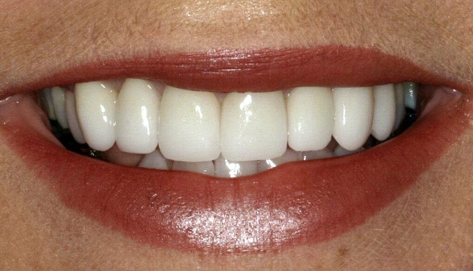
Smile and maintain eye contact
Confident
Friendly
Positive
Notes:
8
So what do you do to give a good 1st impression? You should walk into the room, introduce yourself and reach first for the handshake.
Limp – conveys weakness
Bone crusher – overbearing or arrogant
Wet fish – nervous, apprehensive or apathetic
Southern Bell….

Slide 9
Smile
“Every time you smile at someone, it is an action of love, a gift to that person, a beautiful thing.”
Mother Theresa
“Of all the things you wear, your expression is the most important.” Janet Lane
Notes:
9
Be sure to smile and maintain eye contact

Slide 10
Women
Do wear:
Dark colored jackets with matching skirt or slacks
Closed toe dress shoes with a 2 to 3 inch heel
Plain hose
Well groomed hair and nails
Notes:
A smile shows you are warm, caring, likeable, friendly and positive.
If your 1st impression is positive the employer will listen to what you have to say.
10

Slide 11
Female Professional Attire - Formal
Suit
(with knee length skirt
Or
Matching*, ankle length pants)
Blouse
Dress Pants
Dress Shoes
Source: 2008 Microsoft Corporation
Source: 2007 Concord Training Services
*Matching means the pants must be made out of the same material as the jacket.

Slide 12
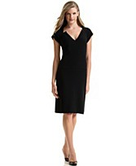
Female – Mid-Range Business Attire – Business Dress
Dress or Skirt
(knee length)
Blouse
Dress Pants
Dress Shoes
Source: 2008 www5.jcpenny.com
Notes:
You should dress according to the job you are applying for.
In business women should wear dark suits.
12

Slide 13
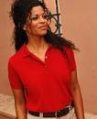
Male & Female Business Casual
Collared Shirt (Tucked)
Dress Pants or Khakis
Non-Athletic Shoes
Source: 2008 She Plays Sports, Inc.
Source: 2007 Hubpages, Inc.
Notes:
13
Avoid these styles…They don’t convey a professional image.
What type of personality do they convey? Flirtatious, playful, airhead?

Slide 14
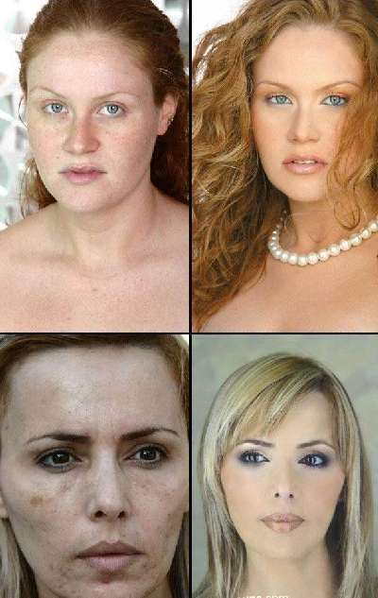
Women
Do wear some
make-up
Before
After
Notes:
14
Department store make up counters can be helpful if you don’t wear make up. Your colors should be in neutral shades and it should be well blended.

Slide 15
Why wear make-up?
Tasteful make-up shows attention to detail
Studies show women who wear make-up earn 20 to 30 percent more money
Notes:
Studies show women who wear make up earn more money. It shows attention to detail.
15

Slide 16
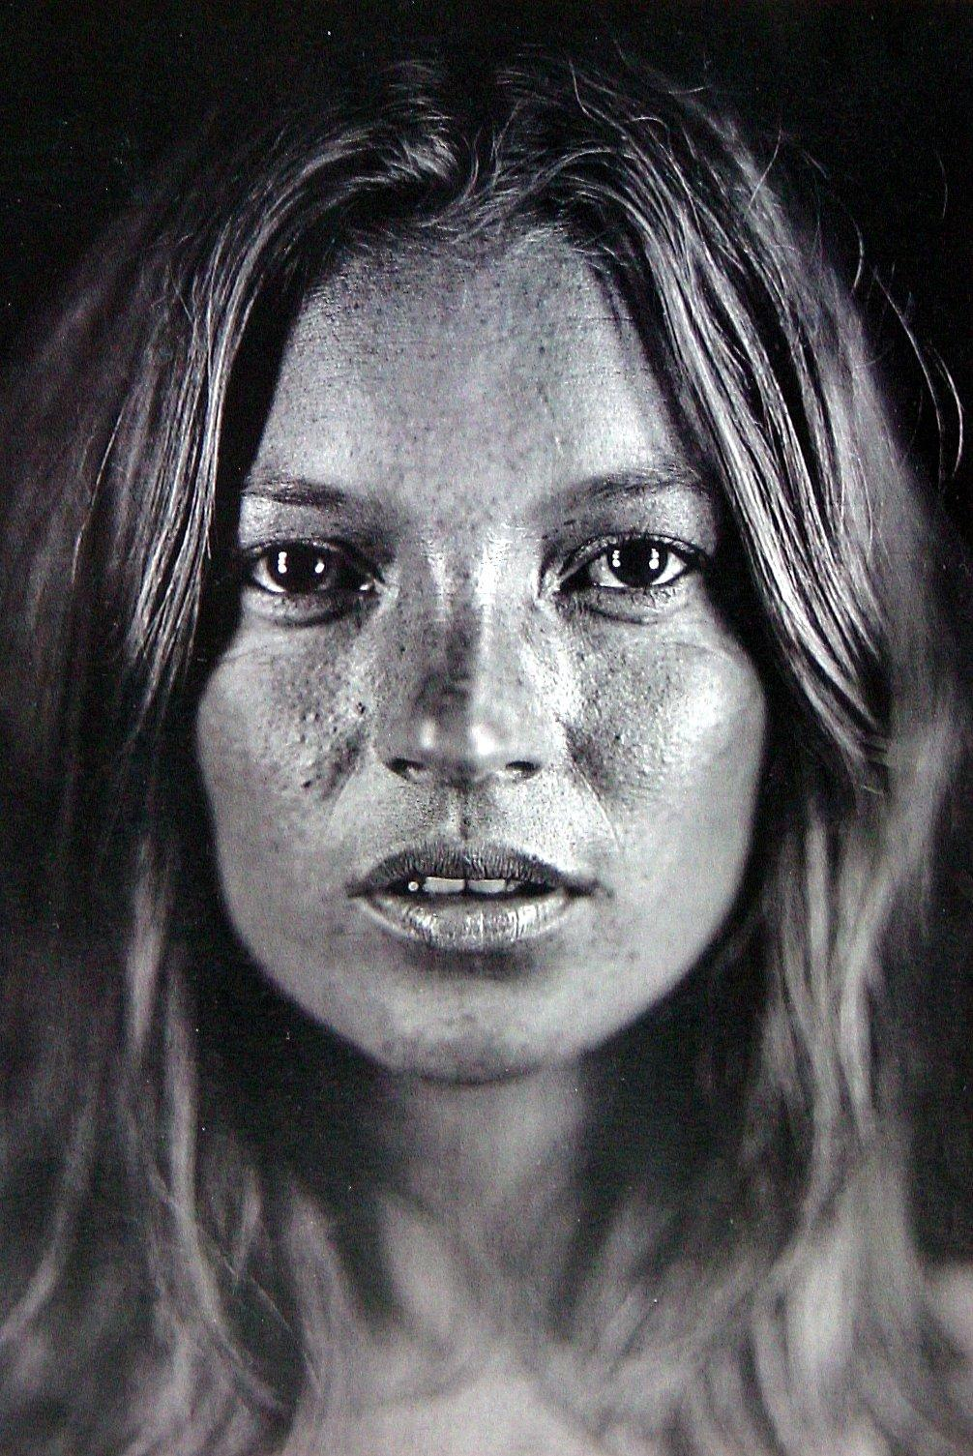
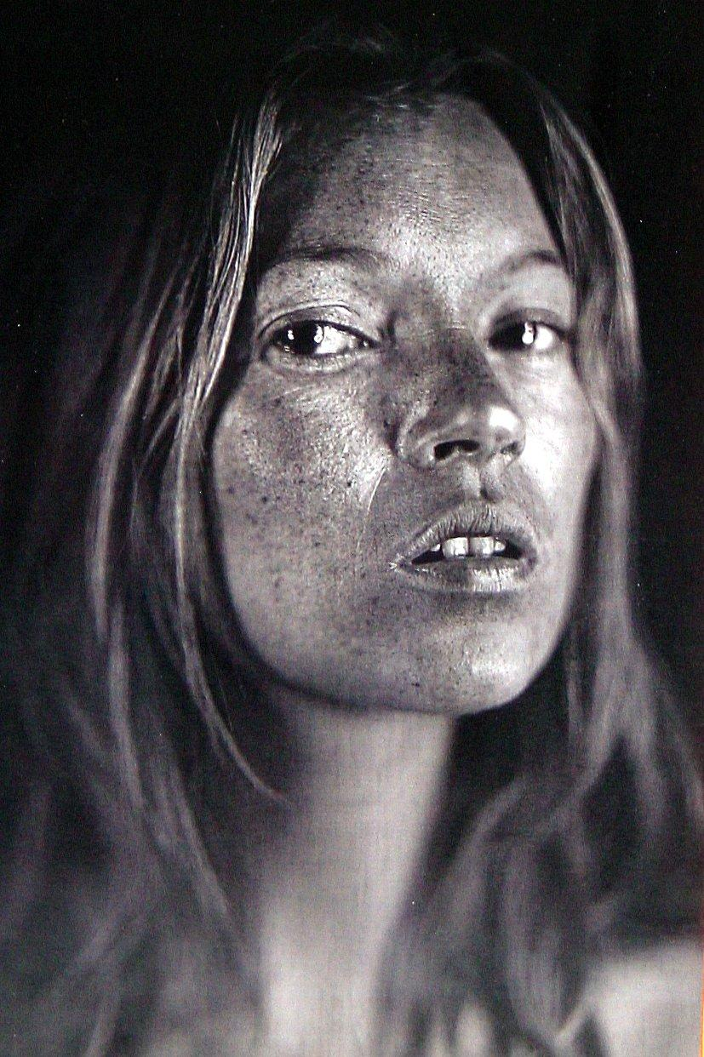
Would make-up help this woman get a job?
Notes:
Would make up help this woman get a job? Do you know who she is?
16

Slide 17
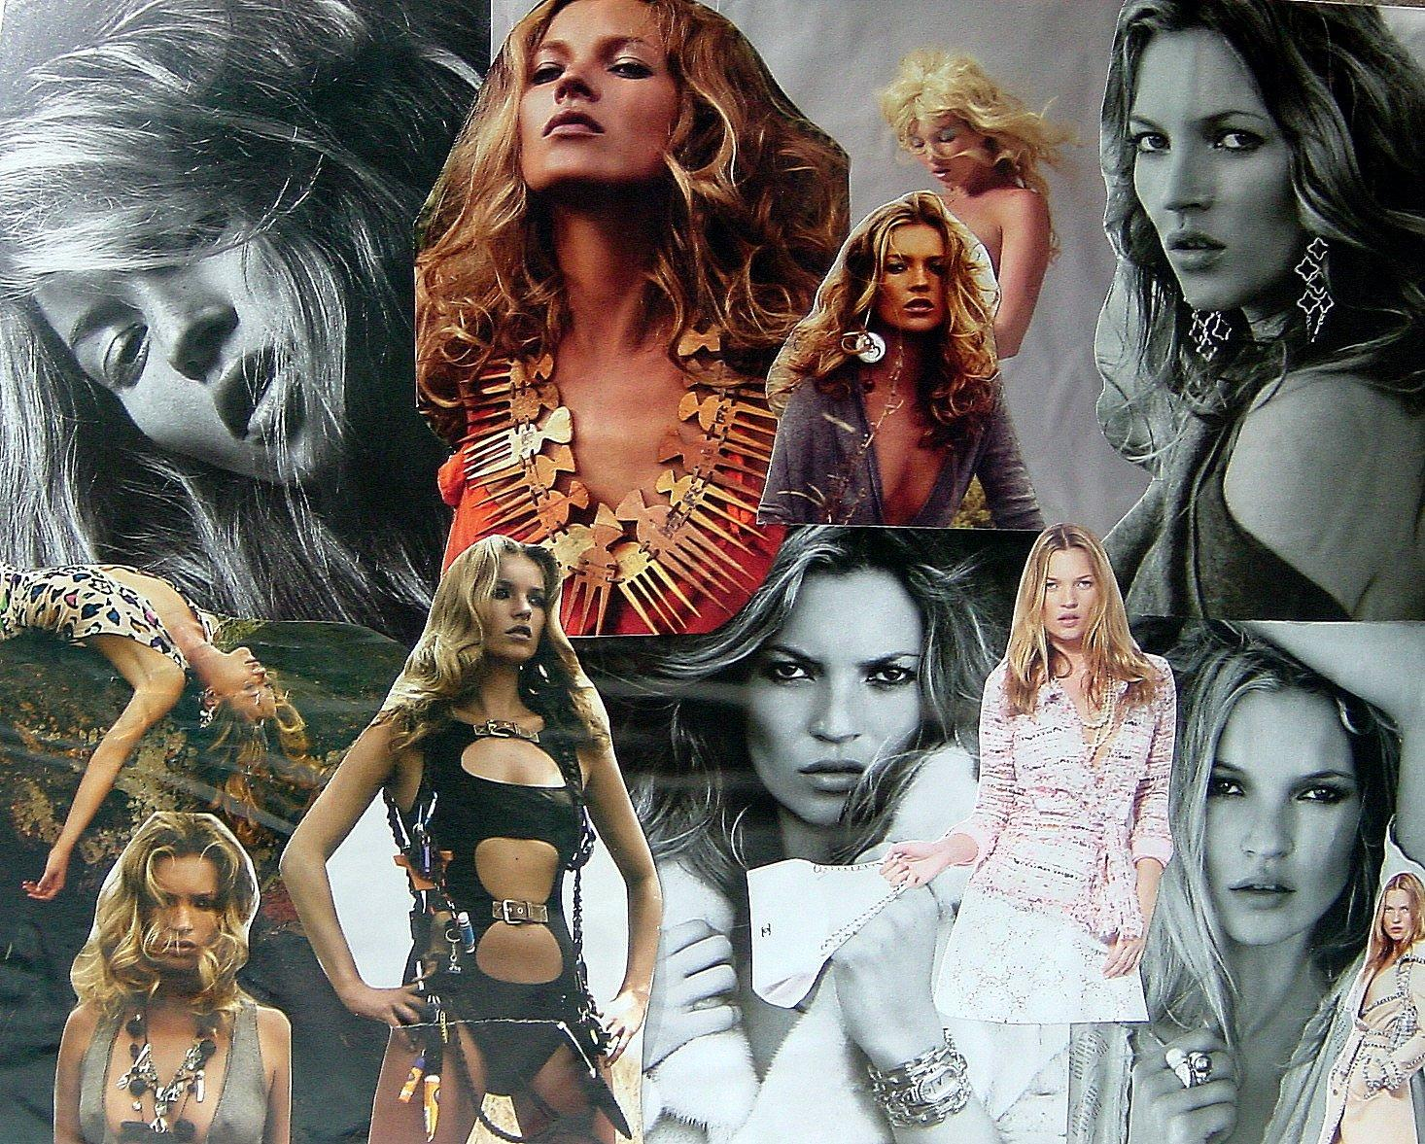
Supermodel Kate Moss
Notes:
Super Model Kate Moss.
17

Slide 18
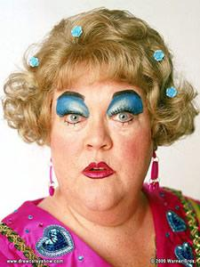
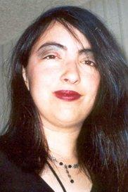
Women
Don’t wear too much make-up

Slide 19
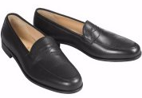
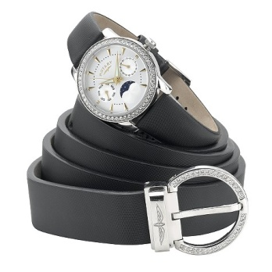
Men
Do wear:
pants that fit at the waist
loafers with dress pants or khakis
Matching belt and shoes

Slide 20
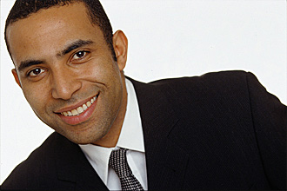
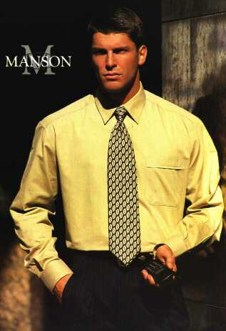
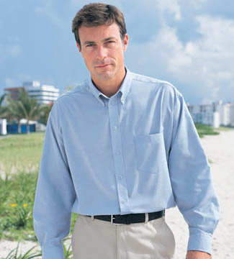
Men
tailored shirts for trim bodies
full-cut shirts for larger physiques
Notes:
20
Remember leather to leather and metal to metal. That means your belt and shoes should match… your belt buckle should match your watch and ring. The color of your leather belt should match your shoe color.

Slide 21
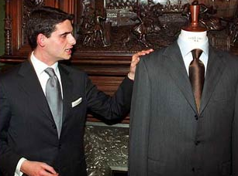
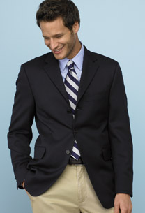
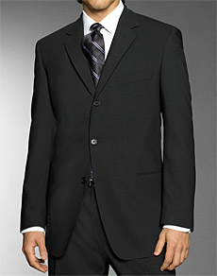
Men
For a power look: a dark-colored suit, white shirt, tie, lace-up dress shoes
For a stylish look: blazer, crew-neck sweater, dress pants, loafers
Notes:
x
21

Slide 22
Male Professional Attire – Formal
Tie
Dress Shirt*
Dress Pants
Dress Shoes
Dress Socks
Source: 2000 - 2008, Jelsoft Enterprises Ltd.
*Shirt must be TUCKED IN!

Slide 23
Male – Mid-Range Business Attire Dress Shirt and Dress Pants
Dress Shirt*
Dress Pants
Dress Shoes
Dress Socks
Source: 2008 Microsoft Corporation
*Shirt must be TUCKED IN!
Notes:
Do you want the Fortune 500 power look…wear a black suit.
If the position you apply for is in a creative field you can relax your dress and go for a stylish look.
23

Slide 24
Dress For the Job
Ask what the dress code is in advance
It’s better to overdress for an interview
Click link to watch video How To Dress For a Job Interview
Notes:
x
24

Slide 25
Men and women
Don’t wear heavy perfume or cologne
Don’t smoke or drink alcohol before the interview
Don’t chew gum
Notes:
Tattoos and piercings should be in areas that can be covered by clothing.
25

Slide 26
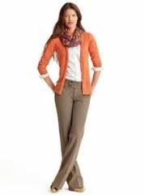
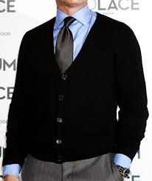
Indeed an Option!
Business Formal Dress
Business
Casual Dress
Business – Mid-Range
Notes:
x
26

Slide 27
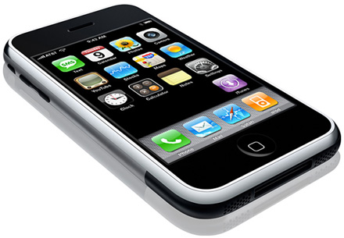
Men and women
Turn off cell phones
Email address
(Is it appropriate for business?)
Arrive on Time!
Notes:
27
Turn phones off! If for some reason your phone needs to stay on make sure it does not have a musical or novelty phone ring.
Avoid e-mail addresses like hotbabe or cooldude…..you can go to yahoo or hot mail and make a generic e-mail just for job contacts if you have to have a cute e-mail.

Slide 28
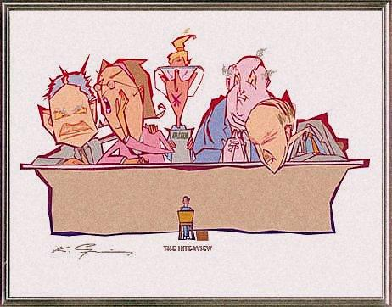
Make your 30 seconds count!

Slide 29
Do Not Wear …

Slide 30
Men
Don’t wear:
trendy clothing
unusual styles

Slide 31
Not an Option!
Skirt Too Short
Source: anitadress.com
Source: traffordcentre.co.uk
Source: 2008 www5.jcpenny.com

Slide 32
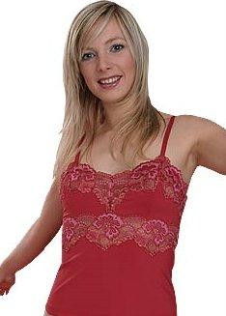
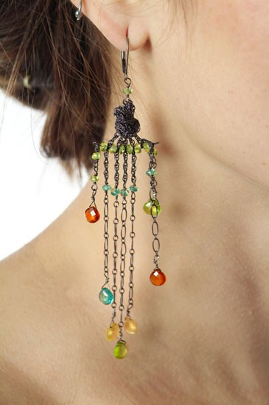
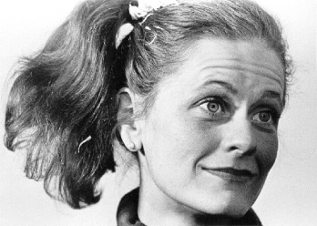
Women
Don’t wear:
short skirts
lingerie-style blouses under suits
mule shoes
ponytails or braids
gaudy or flashy jewelry

Slide 33
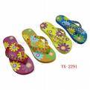
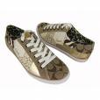
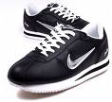
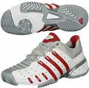
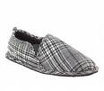
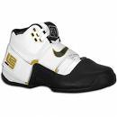
What NOT to Wear
Flip Flops
NO
Athletic
Shoes
Source: lakewoodconferences.com
Bedroom Shoes
Source: 2008 Microsoft Corporation
Source: www.champsports.com

Slide 34
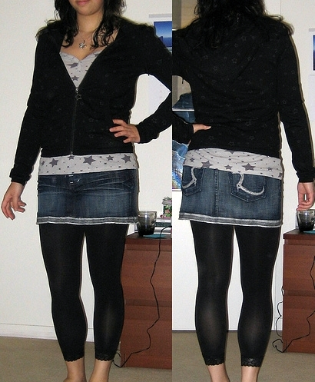
Not an Option!
Leggings with top: Leggings under skirt:
Notes:
34

Slide 35
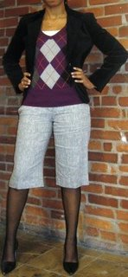
Not an Option!
Pants Too Short
Source: RedeyeChicago.com
Source: 2008 eLuxury.com Inc.
Source: RedeyeChicago.com
Source: 2008 Ann Taylor Retail, Inc.

Slide 36
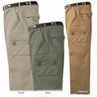
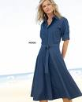
No – Not an Option!
Cargo Pants
Source: 2008 Levi Strauss & Co.
2005 Kevin's Fine Outdoor Gear & Apparel
Denim
Source: Cottontraders.com

Slide 37
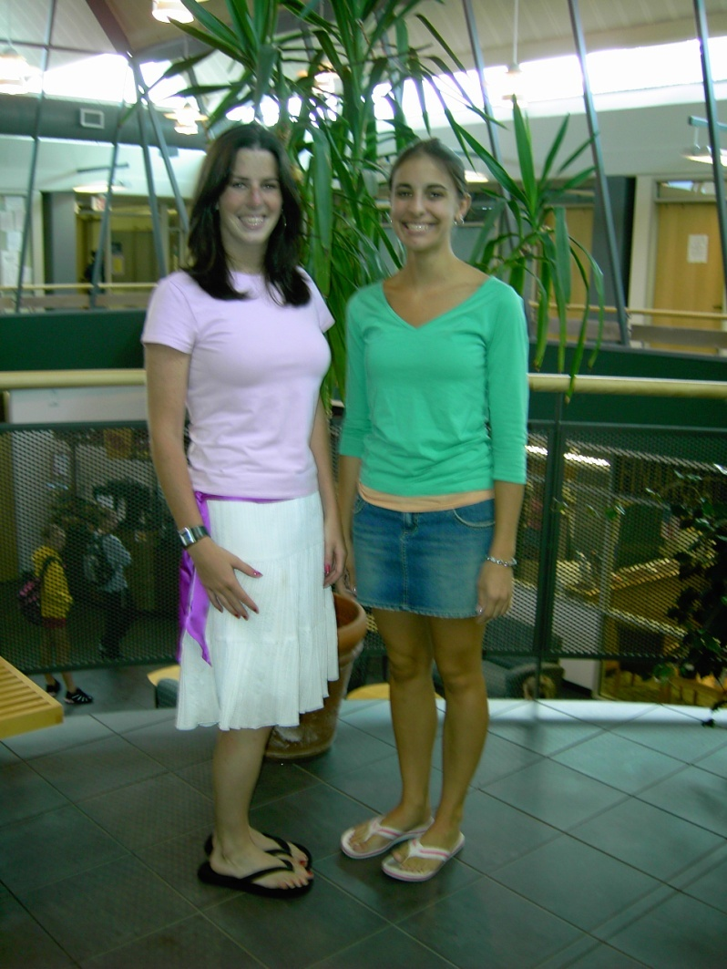
Trendy, revealing, casual, or wrinkled clothing

Slide 38
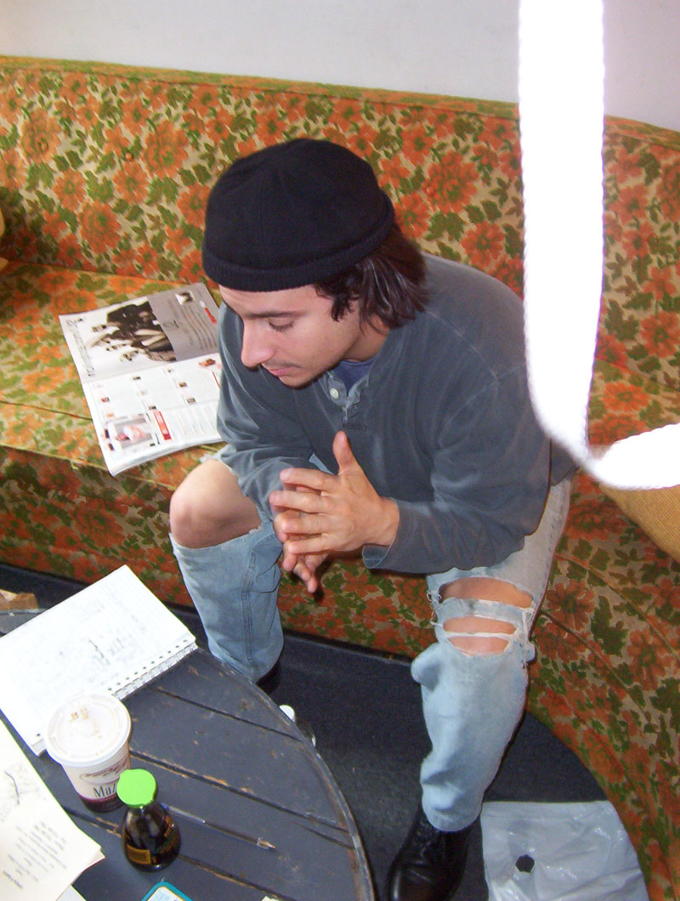
Clothing that is ripped or torn

Slide 39
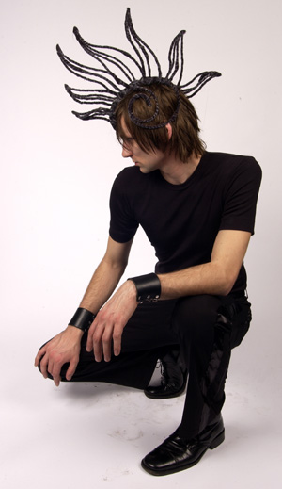
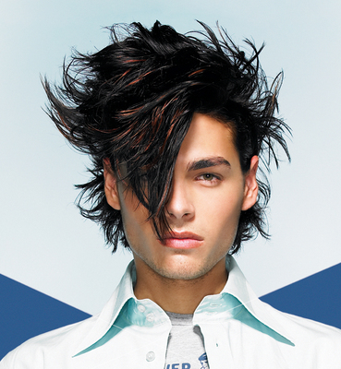
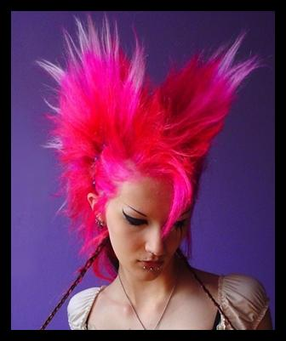
Unusual or strange hairstyles or colors

Slide 40
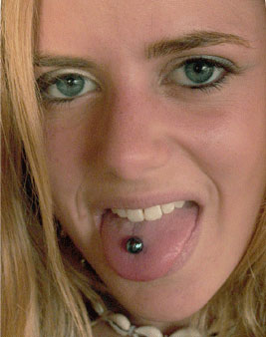
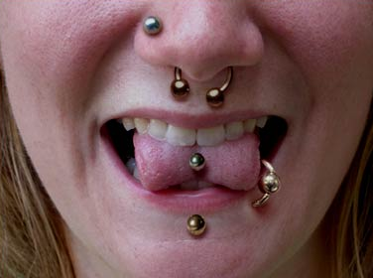
Tongue piercings that cause speech impediments

Slide 41
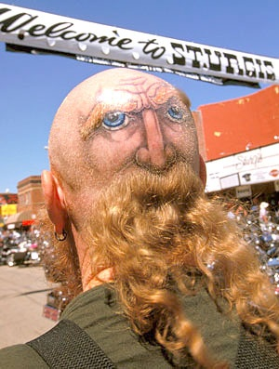
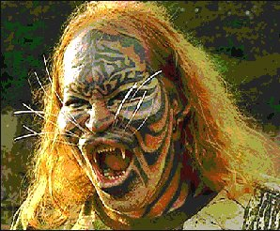
Tattoos in locations that can’t be covered with clothing

Slide 42
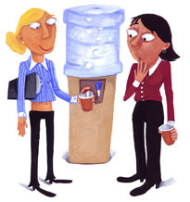
Low rise pants

Slide 43
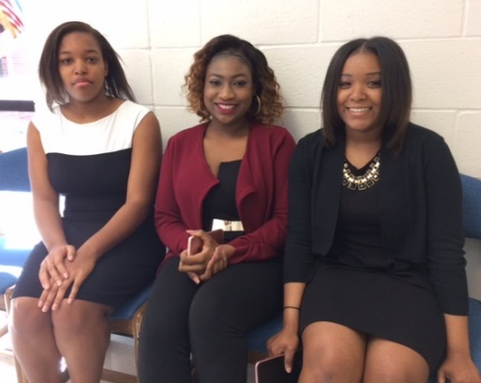
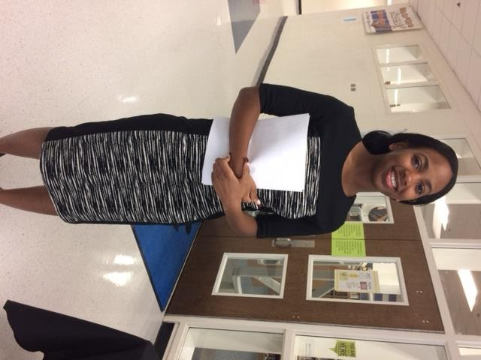
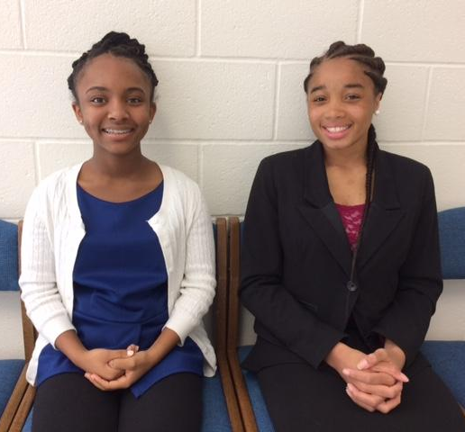
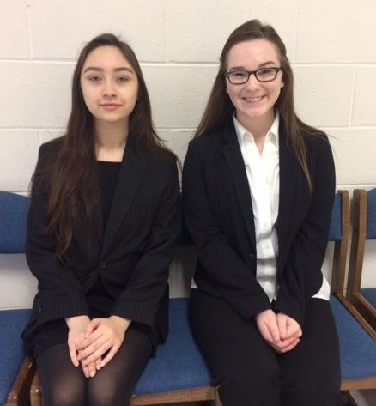
Dress For Success –
ELHS Mock Job Interview Fair

Slide 44
Dress For Success
1st Dress for Success Day will be given to students
Dates will be given by teacher
Not mandatory
Review Formal vs. Casual Dress Attire Handout

Slide 45
Questions?

